Slide 1
Shakespeare’s Works

Slide 2
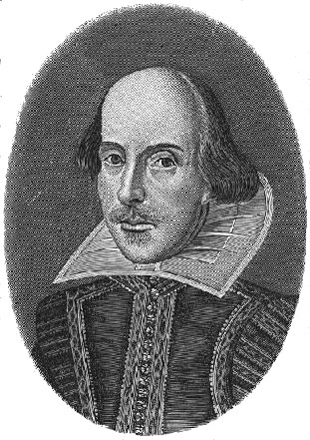
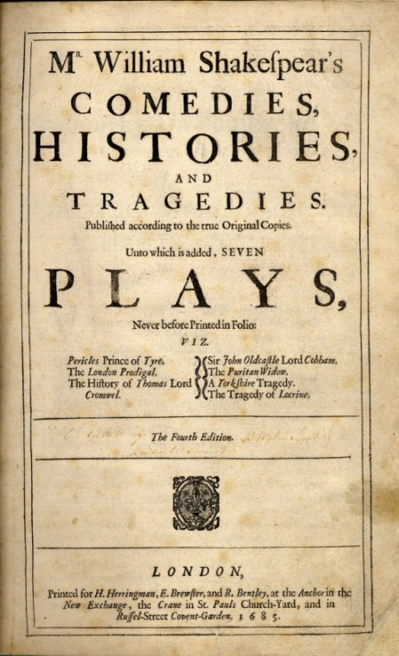
Trivia
It is thought that Shakespeare wrote at least 37 plays. They fell into 3 categories: comedies, histories and tragedies.
He also wrote 154 sonnets. These are long poems made up of 14 lines. They get their name from the Italian for ‘Little Song’.
The character of’ Bardolph’ appears in 4 of Shakespeare’s plays: Henry IV Part 1, Henry IV Part 2, Henry V and The Merry Wives of Windsor.
Shakespeare took the plots and stories for many of his plays from existing stories or events from history. For example, his play Julius Caesar and Anthony and Cleopatra were based on the events and lives of the ancient Romans.
Shakespeare’s works have been translated into over 80 languages.
Today, there is a theatre company based in Stratford that performs only plays written by Shakespeare. It is called the Royal Shakespeare Company.
Shakespeare’s longest play is Hamlet, and the shortest is The Comedy of Errors.

Slide 3
Romeo and Juliet
Two rival families live in the city of Verona in Italy, the Capulets and the Montagues. The families hate each other. Romeo is a Montague boy and is about 16 years of age, and Juliet is a Capulet girl of about 14.
Juliet’s father wants her to marry Count Paris and throws a party to introduce them to each other. Romeo and his friends hear about t party and decide to go in disguise. At the party, he meets Juliet and they fall madly in love with each other. Because the families hate each other so much, Romeo and Juliet decide to get married in secret.
The two families continue to fight and Juliet’s cousin Tybalt picks a fight with Romeo’s best friend Mercutio. Romeo tries to stop the fighting, but his friend Mercutio is accidentally killed by Tybalt.
In anger Romeo kills Tybalt and is banished from Verona as a punishment. Juliet does not know about the fight, but when she finds out, the kindly Friar who married them arranges for her and Romeo to spend one last night together before Romeo is sent away.
Meanwhile, her father, who still does not know she is married to Romeo, decides to bring her wedding to Count Paris forward to try and make the family forget Tybalt’s death. Juliet tells her mother and father she does not want to marry Count Paris, but still does not tell them why. Her mother and father are very angry with her.
Juliet goes to Friar Lawrence again and together they plan a way that Romeo and Juliet can let their families know they are married. He gives Juliet a sleeping potion that will make her seem dead. When he father and mother go to wake her in the morning they are think she has died in her sleep.
The Friar sends a message to tell Romeo to come to the Capulet's family monument to rescue his sleeping wife. But the message gets mixed up and Romeo believes Juliet is really dead. He is so sad that he buys some poison in order to kill himself.
He returns to Verona and goes to the tomb where Juliet lies sleeping. Count Pairs is also there and Romeo, blinded by anger and love, kills him. Romeo then takes the poison and dies just as Juliet wakes from her drugged sleep.
Friar Lawrence tells her what happened but she refuses to leave Romeo and stabs herself.
The deaths of Romeo and Juliet lead the families to make peace.

Slide 4
The Tempest
A party of Italian royalty is shipwrecked in a storm. The people on board are King Alonso of Naples, his son Ferdinand and brother Sebastian. Also with them are the Gonzalo the Courtier and Antonio, the Duke of Milan.
The storm is watched from the shore by Prospero and his daughter Miranda. Prospero used to be the Duke of Milan. Prospero tells Miranda the story of how his brother Antonio stole his title from him.
With the help of Gonzalo the Courtier, Propsero had managed to escape with Miranda and his books of magic to an island in the Mediterranean. A man called Caliban already lived on the island. Caliban was made to be their slave and their only other companions were ‘spirits’ led by Ariel, whom Prospero had rescued by his magic from imprisonment in a tree.
The Royal party are washed up on the island unhurt, but the King believes his son Ferdinand has drowned. Ferdinand was separated from the others during the storm, and has been washed up elsewhere on the island. He meets Miranda and they instantly fall in love with one another.
Prospero is not happy about this and captures Ferdinand. Ariel speaks to Prospero to try and get Ferdinand released and Prospero promises that he will free him if he does a few tasks first.
Meanwhile, the Royal party is staring to fall out with one another. The King’s brother and Antonio, Duke of Milan plot to kill him. Their attempt is stopped by Ariel and instead she leads them astray making them very confused.
In another part of the island, the court fool, Trinculo, has come ashore and discovers Caliban, who has hidden away in all the confusion. Trinculo hides with Caliban and they are found by the ship's butler Stephano, who has a hidden cask of wine.
The three get very drunk and Caliban gets them to agree to help him kill Prospero and make Stephano lord of the island, but they are found out by Ariel who reports them to Prospero.
Ariel rounds up the rest of the royal party and they are all brought to Propsero. He has realised that his daughter truly loves Ferdinand and instead of revenge he blesses the marriage of Ferdinand and Miranda. He also forgives his scheming brother Antonio and gets back his title of Duke of Milan.
The play ends as everyone celebrates their reunions.

Slide 5
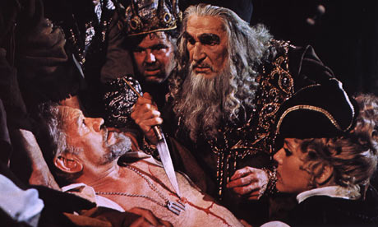
The Merchant of Venice
An Italian man Bassanio needs money impress a girl called Portia. He asks his friend Antonio, the Merchant of Venice to lend him the money.
Antonio agrees but is a bit short of cash as it is all tied up in his ships which are at sea, so he suggests that Bassanio borrows the money from one of Venice’s moneylenders and says he will the loan back from Bassanio.
They approach a Jewish money lender called Shylock for the loan. Shylock and Antonio go way back, but they don’t like each other – Antonio has insulted Shylock on many occasions.
Shylock lends the money, but says if it is unpaid, then he wants a pound of Antonio’s own flesh. Antonio agrees to the terms of the loan.
Meanwhile , Portia’s father has decided on a task for any man who wants to marry his daughter. They must choose a box and if they make the right choice, they can marry Portia – so far no one has chosen correctly.
Bassanio arrives at Portia’s estate and they fall in love with each other. Fortunately, he also picks the correct box . Portia gives him a ring as a token of their love and makes him swear he will never part with it.
News arrives that Antonio’s ships have been wrecked and Shylock is after his pound of flesh. Bassanio returns to Venice to try and save Antonio’s life. Unknown to him, Portia follows disguised as a man.
Portia examines the contract and says it is legal, but warns Shylock that the contract does not mention any blood, so she tells Shylock he can have his pound of flesh if he does so without spilling any of Antonio’s blood.
Shylock is told he has to pay Antonio for the upset he has caused, but Antonio refuses his money saying he wants Shylock to convert to Christianity instead – Shylock reluctantly agrees.
Bassanio goes to thank the lawyer (Portia in disguise) and gives him the ring as gratitude. Portia reveals who she really is and tells off Bassanio for giving away the ring.
Antonio’s ships tern out not to have been shipwrecked and they all live happily ever after!

Slide 6
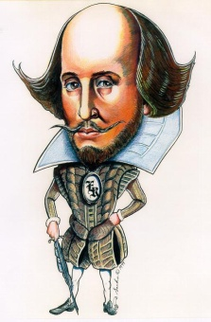
The Seven Ages of Man
William Shakespeare is England’s most famous writer. He loved plays that much that he once said life was a bit like a play and we go through life in seven scenes. In his play As You Like It, the character Jacques says the famous Seven Ages of Man speech.
If we could put the life of Shakespeare into seven scenes, maybe it would
look a bit like this.
“All the world’s a stage ,
And all the men and women merely players:
They have their exits and their entrances;
And one man in his time plays many parts,
His acts being seven ages.”
ACT 1: “At first the infant,
Mewling and puking in the nurses arms.”
April 1564: William Shakespeare is born.
ACT 2: “Then the whining schoolboy, with his satchel,
And shining morning face, creeping like a snail
Unwillingly to school.”
Shakespeare attends his local grammar school.
ACT 3: “And then the lover,
Sighing like a furnace, with a woeful ballad,
Made to his mistress’ eyebrow.”
Shakespeare marries Anne Hathaway when he is 18.
ACT 4: “Then a soldier,
Full of strange oaths, and bearded like the pard,
Jealous in honour, sudden and quick in quarrel,
Seeking the bubble reputation,
Even in the cannon’s mouth.”
Shakespeare makes his way to London in May 1592 and fights to make his way and his name in the theatre.
ACT 5: “And then the justice,
In fair round belly with good capon lined,
With eyes severe and beard of formal cut,
Full of wise saws and modern instances;
And so he plays his part.”
Shakespeare has become a successful playwright and his plays are famous in London. He has bought a family home “New Place” with his wealth.
ACT 6: “The sixth age shifts
Into the lean and slippered pantaloon,
With spectacles on his nose and pouch on his side,
His youthful hose well saved, a world too wide
For his shrunk shank; and his big manly voice,
Turning again towards childish treble, pipes
And whistles in his sound.”
Shakespeare has retired from theatre life in London
ACT 7: “Last scene of all,
That ends this strange and eventful history,
Is second childishness and mere oblivion,
Sans teeth, sans eyes, sans taste, sans everything.”
Shakespeare is a grandfather now and dies in 1616 an old man of 52 (it was old in those days).

