Slide 1
Propaganda Techniques
15 techniques that work

Slide 2
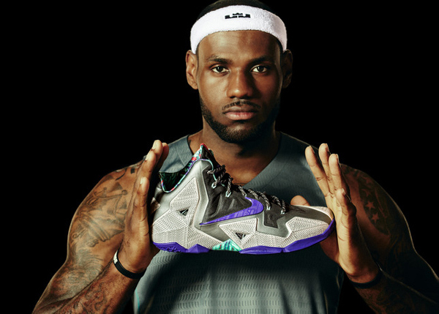
Appeal to Authority
Appeals to an authority to support a position, idea, argument, or course of action.
Example: LeBron James trusts his feet to only one shoe when he is playing ball: Nike
Authority: LeBron James (professional); Idea/Product: Nike Shoes

Slide 3
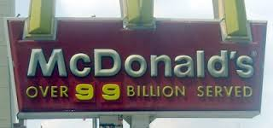
Bandwagon
This promotes an “everyone else is doing it, you should too” appeal.
Example: Four of five Dentists recommend this toothpaste/brush

Slide 4
Glittering Generalities
Use of intensely emotionally appealing words so closely associated with highly valued concepts and beliefs that they carry conviction without supporting information or reason.
Example: If you love this country, you will buy this product.

Slide 5
Time Crunch
Creating the impression that your action is required immediately or your opportunity will be lost forever.
Example: This offer is good for the first 100 callers!

Slide 6
Plain Folk
Using people just like you and me to state a case.
Example: If you have dandruff like I do, you’ll want to use this shampoo! It worked for me!

Slide 7
Red Herring
Highlighting a minor detail as a way to draw attention away from more important details or issues.
Example: Order this oven now, and we’ll throw in a free cutlery set.

Slide 8
Transfer
Linking a known personal goal or ideal with a product or cause in order to transfer the audience’s positive feelings to the product or cause.
Example: For every dollar spent on our product, we will donate five percent to the American Cancer Society.

Slide 9
Snob Appeal
Associating the product with successful and admired people to give the audience the idea if they buy or support the same things, they may also have “what it takes.”
Example: Buy a BMW: the Ultimate Driving Machine

Slide 10
Testimonial
Using the testimony or statement of someone to persuade you to think or act as he or she does.
Example: Bob Dole uses Head and Shoulder

Slide 11
Prestige Identification
Showing a well-known person with an object, person, or cause in order to crease the audience’s impression of the importance or prestige of the object, person, or cause.
Example: Cindy Crawford only wears Rolex watches

Slide 12
Flag Waving
Connecting the person, product, or cause with patriotism.
Example: Chevrolet – as American as apple pie.

Slide 13
Card Stacking
Telling one side of the story as though there is no opposing view.
Example: There is simply no better vacuum clearer on the market!

Slide 14
Obtain Disapproval
Getting the audience to disapprove of an action or idea by suggesting the idea is popular with groups hated, feared, or held in contempt by the target audience.
Example: Why would you vote for this candidate? He has accepted donations for the tobacco industry!

Slide 15
Vagueness
Statements that are generally vague so that that audience may supply its own interpretations
Example: Everything in the store is on sale! Save up to 75%!

Slide 16
Fear
Appealing to a person’s desire to fit in with the crowd.
Example: Are you sure your deodorant is providing you with enough protection?

