Slide 1
Identity and Conformity
Introduction to thematic units and paragraphs

Slide 2
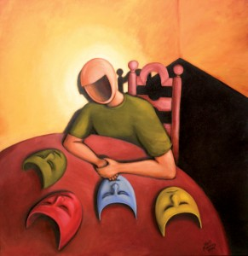
Definitions
Identity
1. the state or fact of remaining the same one or ones, as under varying aspects or conditions: The identity of the fingerprints on the gun with those on file provided evidence that he was the killer.
2. the condition of being oneself or itself, and not another: He doubted his own identity.
3. condition or character as to who a person or what a thing is: a case of mistaken identity.
4. the state or fact of being the same one as described.
5. the sense of self, providing sameness and continuity in personality over time and sometimes disturbed in mental illnesses, as schizophrenia.
6. exact likeness in nature or qualities: an identity of interests.
7. an instance or point of sameness or likeness: to mistake resemblances for identities.

Slide 3
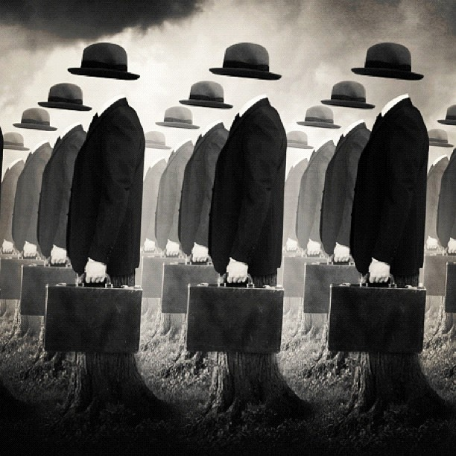
Definitions cont.
Conformity
1. action in accord with prevailing social standards, attitudes, practices, etc.
2. correspondence in form, nature, or character; agreement, congruity, or accordance.
3. compliance or acquiescence; obedience.
4. compliance with the usages of an established church, especially the Church of England.

Slide 4
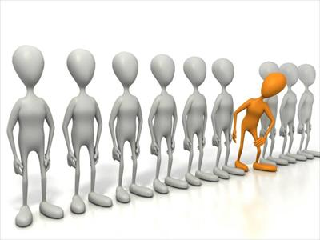
Thoughts?
Text it in:
Phone #: 37607
Message:
1148111 + your message

Slide 5
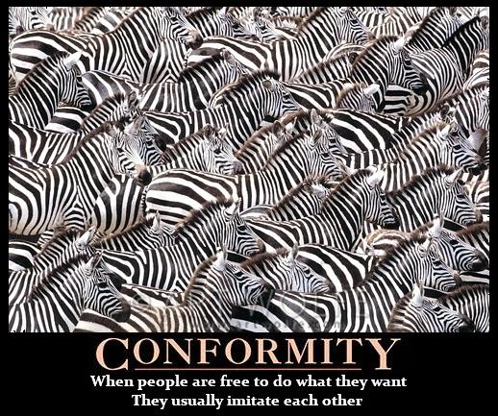
Thoughts?
Is this accurate?
Why? Why not?
Why might this occur?

Slide 6
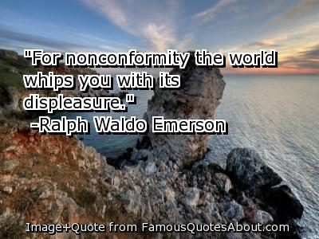
Thoughts?
Agree? Disagree?
Why? Why not?
Examples?

Slide 7
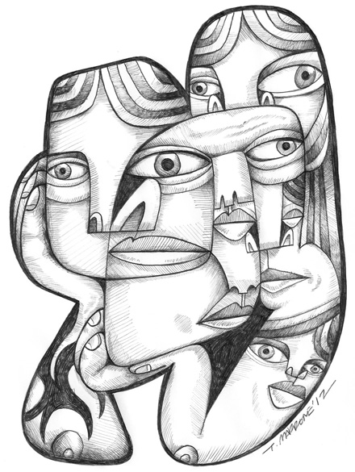
Task
Find an image related to conformity and one on identity that you find informative or revealing. Place the image in a document and write an explanation of what the picture means and why you might agree or disagree with it.

Slide 8
Homework – due Monday Oct. 27th
Read Kurt Vonnegut’s “Harrison Bergeron”
Answer the questions online ↓ for each correct response, you will receive 20 XP (7 Q’s = 140XP)
Homework quiz on Monday (different questions)

