Slide 1
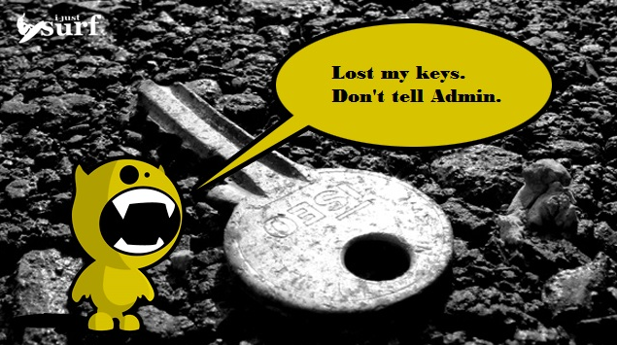
http://ijustsurf.com/reviews/%E2%80%9812-days-of-xmas%E2%80%99-1-surf-session-saver-key-lock-box/

Slide 2
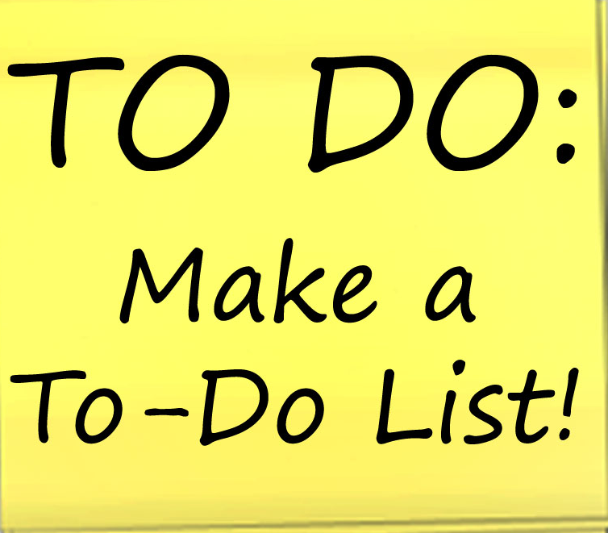
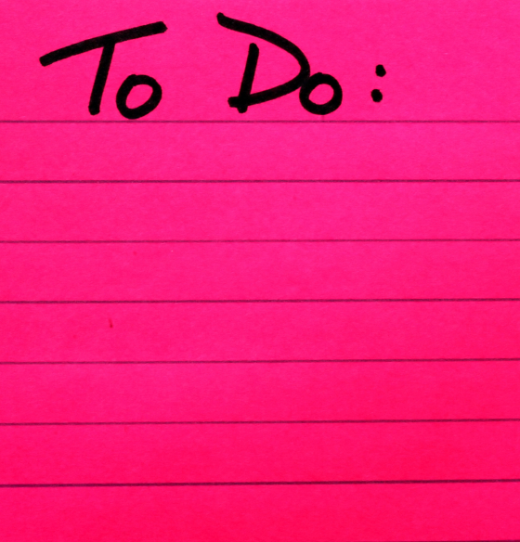
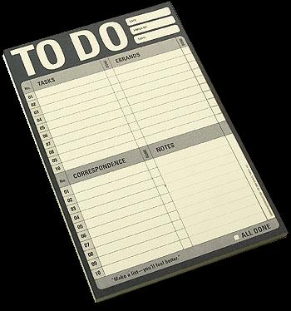
I Love my to do lists.

Slide 3
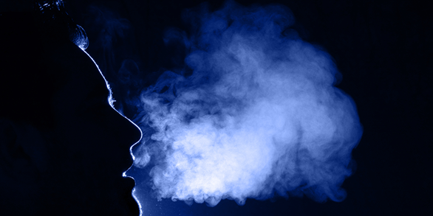
Breathe in. Breathe out. You’re ok.

Slide 4
The best advice
comes from nature.

