Slide 1
Character Sketches
How to write a character sketch

Slide 2
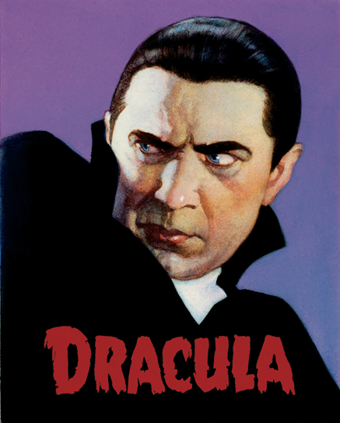

Slide 3
Character Sketches Formula
Introduction sentence (1 sentence)
Background information (1-2 sentences)
Thesis/Claim (1 sentence)
Characteristic 1 + proof (2-3 sentences)
Characteristic 2 + proof (2-3 sentences)
Characteristic 3 + proof (2-3 sentences)
Concluding sentence (1 sentence)

Slide 4
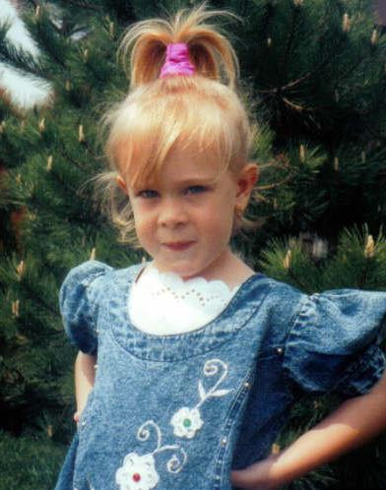
Example/Model Text
Introduction sentence (1 sentence)
Background information (1-2 sentences)
Thesis/Claim (1 sentence)
Characteristic 1 + proof (2-3 sentences)
Characteristic 2 + proof (2-3 sentences)
Characteristic 3 + proof (2-3 sentences)
Concluding sentence (1 sentence)

Slide 5
Your Turn
For Wednesday
Using the formula, write a personal character sketch

