Slide 1
Auto-Fail Words A-Z
(Please Use these words Properly, or do it again)

Slide 2
A- Their/There/They’re
Do you know how to use these words?
Their=
There=
They’re=

Slide 3
B- Two/ Too/ To
Two= the number 2
Too= as well
To= direction, eg. Go to the candy store. The letter is addressed to her.

Slide 4
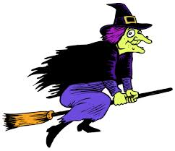
C- Which/ Witch
Which= Which color is your favorite? (specifying an object or idea)
Witch=

Slide 5
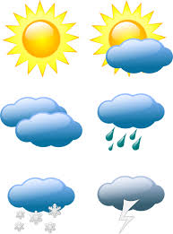
D: Weather/whether
I was wondering whether I should go to the dance or not (a choice between alternatives).
weather=

Slide 6
E. Gonna
=Going to

Slide 7
F. Wanna
=Want to

Slide 8
G. U, R (text speak)
= you
= are

Slide 9
H. Library
Please know how to spell it.

Slide 10
I. Definitely is spelled like this.
Definitely

Slide 11
J. Because
Baby Eats Candy Apples Until She Explodes

Slide 12
K. Should of
=Should have
=I should have told her how I felt about her.

Slide 13
L- A lot
A lot is two words, not one.

Slide 14
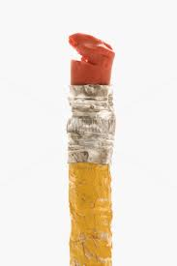
M. Whose/who’s
Who’s= Who is
Whose= Belonging to a person
Whose pencil is this?

Slide 15
N. Pairs/pears
-Pairs=
-pears=

Slide 16
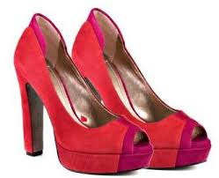
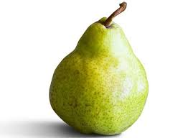
N. Pairs/pears
Pairs= pairs of shoes
Pears= fruit

Slide 17
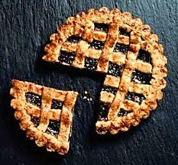
0. Peace/piece
Piece=
Peace=

Slide 18
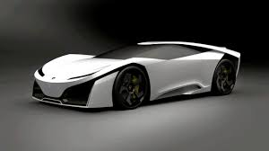
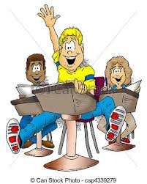
P. Knew/new
You have won a New car!
He knew the answer!

Slide 19
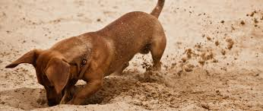
Q. Its/it’s
Its= belonging to something
The dog buried its bone.
It’s= it is
It’s cold outside.

Slide 20
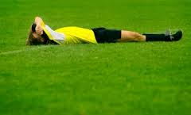
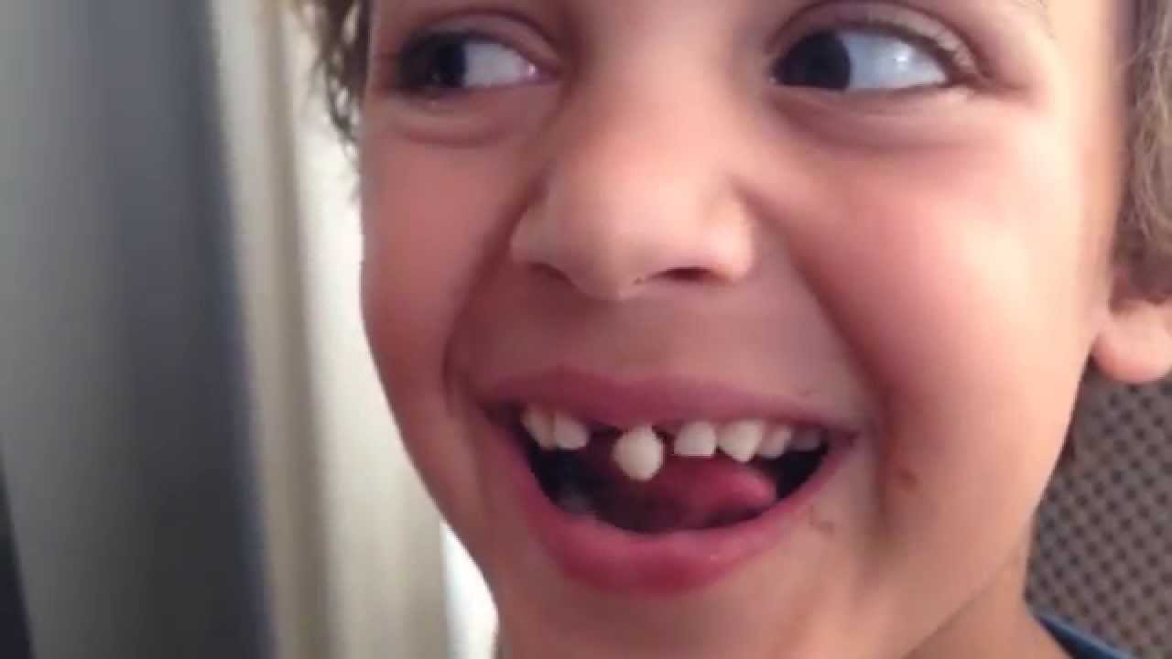
R. Lose/loose
Lose: Did you lose the game?
Loose:
I have a loose tooth!

Slide 21
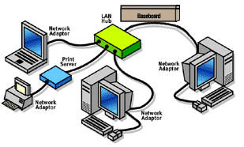
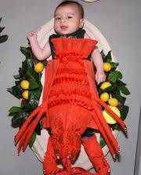
S. Weird/wired
This is my dad’s wired network.
Poor kid, that outfit is weird.

Slide 22
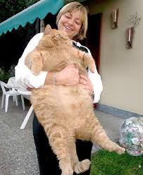
T. You’re/your
You’re= you are
Your= belonging to you
This is Your large cat…

Slide 23
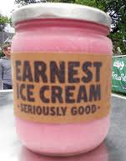
U. then/than
Then=after
Let’s go to the movies, then go out for ice-cream.
Than= introducing the second element in a comparison
I was taller than her in second grade.

Slide 24
V. Decision
This is how you spell decision.

Slide 25
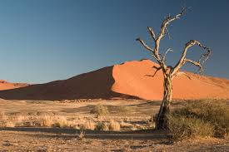
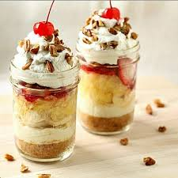
W. Desert/dessert
Desert has one s.
We always want two servings of dessert.
Two s’s in dessert

Slide 26
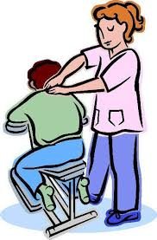
X. Message/massage
massage=
message=

Slide 27
Y. Wednesday
Wed-nes-day

Slide 28
Z. Citton /Campbell
C-i-t-t-o-n = two t’s
Camp
bell

